Slide 1

1

Slide 2


Slide 3

TEAM
NAZIM 34
AMAL 8
SAYOOJ 50
ATHUL 18

Slide 4
INTRODUCTION
The Era is discussing the various possibilities of making Life more easy and Smart
When mobile phones were introduced, using microcontrollers, it could just do phone calls
But now, we have smartphones that are powerful than the PC or laptops we use
So, Why do we call something smart?
“SMART” is a prefix given to certain equipment that does something more than they were actually programmed to do..

Slide 5
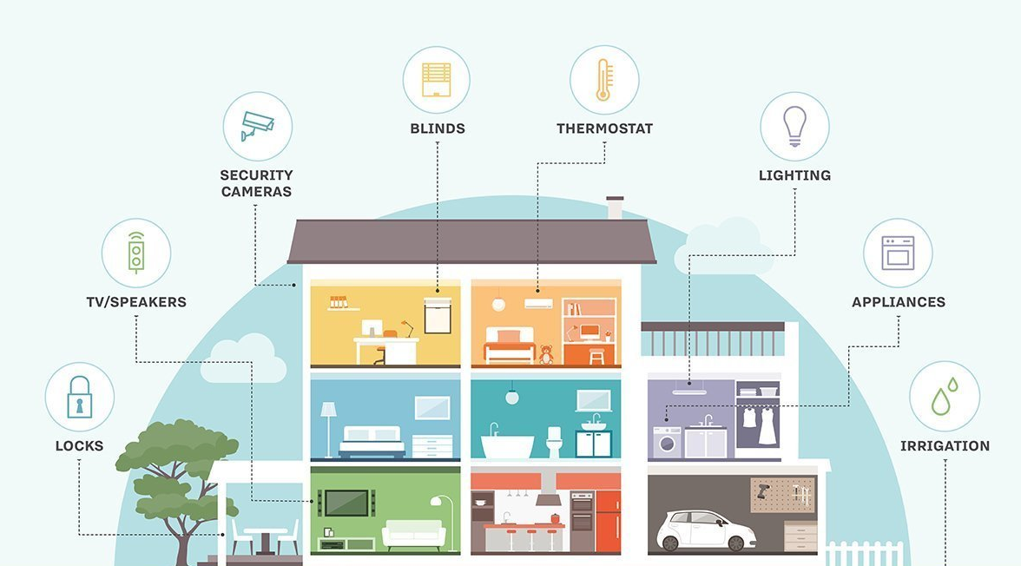
Smart Homes

Slide 6
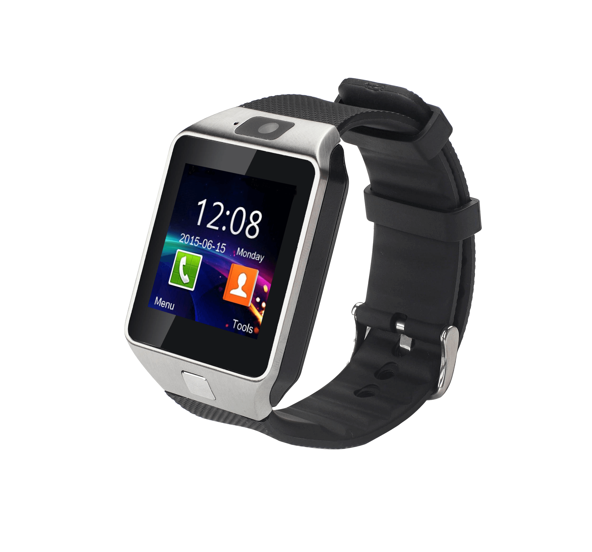
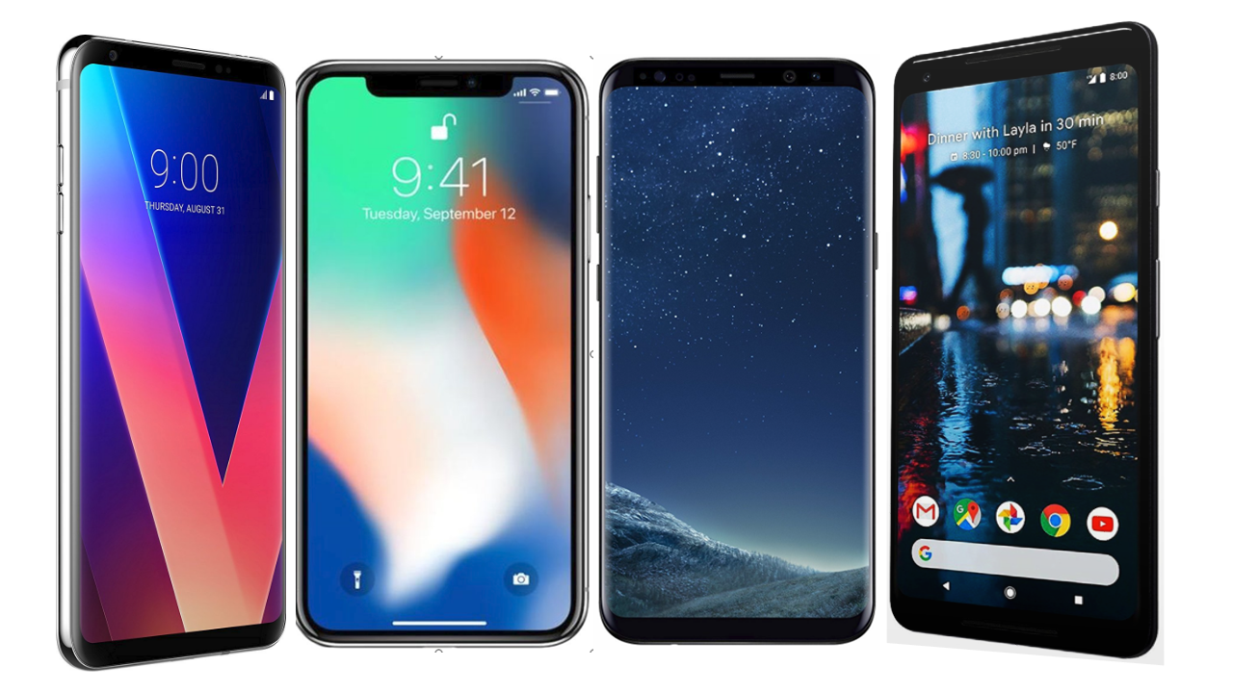
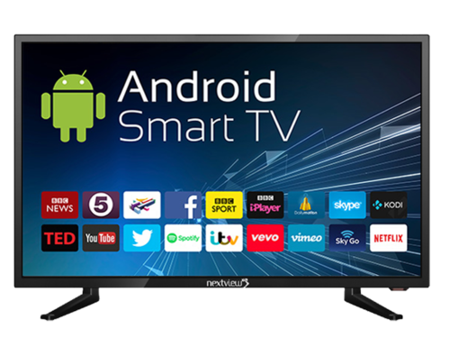
SMART PHONES
SMART WATCHES
SMART TELEVISION

Slide 7
THE PATH OF INSPIRATION
World war 2 ends
SMILEY
Tesla remote boat
People don’t know who Harvey is
He designs the smiley
1898
1945
1959
1963
1969
1970
Harvey Ball Advertising
balls
Enters into ad making
Smiley Balls Were Introduced
Clapper
MICROCONTROLLER
Was invented, marked the first step to smart homes
Demand began to increase
1996
1984
1972
1971
1898-2018
120 YEARS
1997
Smart Homes
ALOHAnet
Idea of mart homes was put forth
First wireless network
Millenium British Home excibition
Alexa
First smart home excibition
Initial Launch
1998
2011
2014
2016
2018
SIRI
Google Assistant
Initial Launch of SIRI
Initial Launch

Slide 8
AUGUST
SEPTEMBER
OCTOBER
Team Formation
USE CASE DIAGRAM
SEPT 14
Aug 16
Milestone 2
PHASE 1 APPLICATIONS
Nov 7
Idea Finalizing
SEPT 6
SEPT 21
Dec 20
PHASE 1
MILESTONE 1
AUG 21
MILEESTONE 3
MILESTONE 4
OCT 22
6 days
2018
Today
NOV
1
10
20
30
10
20
30
10
20
18 days
24 days
TEAM, BRAINSTROMING
AUG 10 - Aug 30
16 days
ABSTRACT SUBMISSION
SEPT 6
25 days
MODUS OPERANDI
SEPT 6 – SEPT 21
STARTED THE WORKS ON PHASE 1 PRESENTATION
SEPT 23
TEAM TOPIC PARTITIONIING AND RESEARCH
OCT 1 – OCT 16
PHASE 1 PRESENTTION
OCT 22 - ....

Slide 9
ABSTRACT
FORMER TITLE : BALL-E
MODEL : SPHERE
We are familiar with the popular home assistant Alexa, Google Assistant, Siri etc.
What if these could do more and still be compact, flexible, light, fast and easily portable?
That is the idea we chose to share, a spherical shaped home assistant with many more facilities and functions than the three of’em mentioned above could handle together including voice, image recognition, and also can follow us like out pet and be multipurpose in action.

Slide 10

JOY

Slide 11
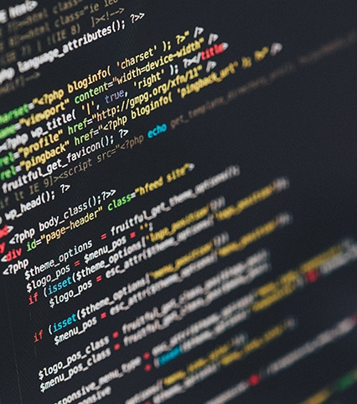
What Is JOY!
Knowing it better

Slide 12
J O Y
I S
A
S M A R T H O M E
C O N T R O L
A N D
C O – O R D I N A T I O N
S Y S T E M

Slide 13
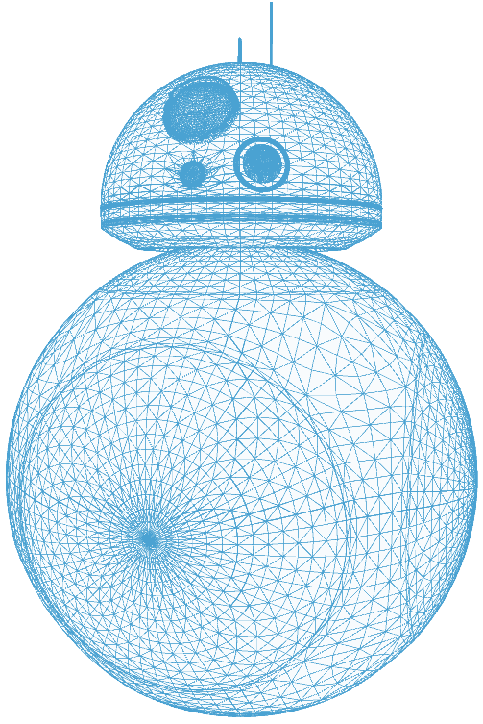
Most Basically, it’s something that rolls..
RESEMBLES BB-8
SINGLE KEYED DOMOTIC SYSTEM
APPLICATION OF IoT
ASSET FOR THE FUTURE SMART HOMES
PROGRAMMABLE MULTIPURPOSE SYSTEM
ACCESSABILITY AND CONNECTABILITY
DEIGNED TO BE PERFECT

Slide 14
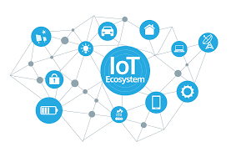
The Internet of things (IoT) is the network of physical devices, vehicles, home appliances, and other items embedded with electronics, software, sensors, actuators, and connectivity which enables these things to connect, collect and exchange data.

Slide 15
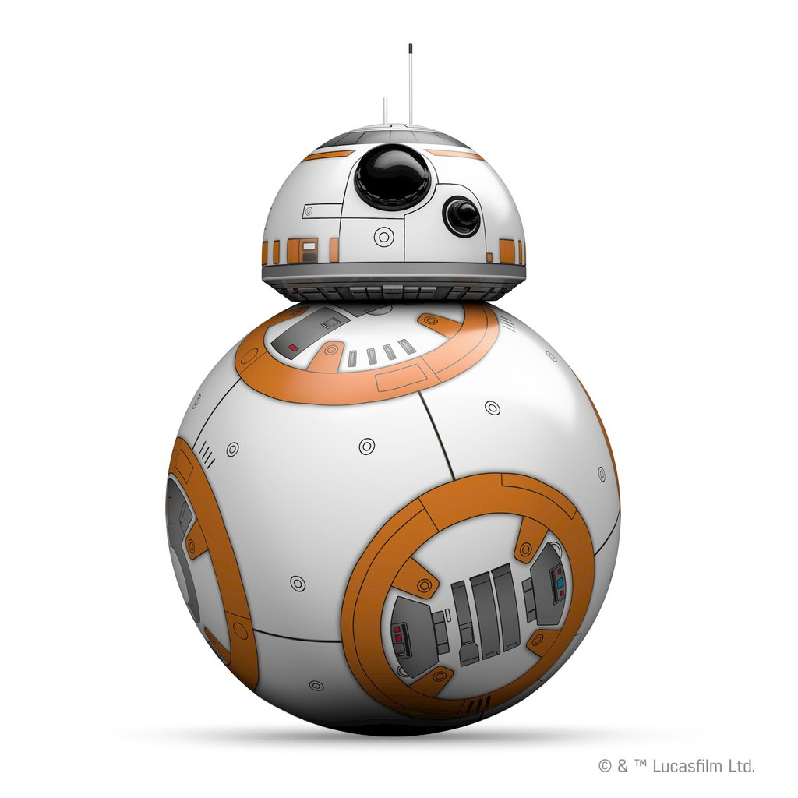
Design Coincidence
BB-8 is an astromech droid that appears on Star Wars Episode VII - The Force Awakens.
It has a ball shaped body and a domed head that resembles that of the R2 series droids, whose most popular unit is R2-D2.
BB-8's body rolls independently from the head, which always stays near the vertical axis of the droid.

Slide 16
USER VIEW
KEEPING AN EYE ON THE ROLLIN’
Although fully automated, we can view the processes through our lap or smartphone which is connected to joy via internet.
The middle layer of the sphere has a 360 vision camera with 90% coverage of stills.
Commands could also be given via this device like : “Clean the floor at 8 AM”, “Switch off the AC at 9PM”, “Make an appointment at the saloon at 5PM” etc.
The maximum number of devices that can be connected shall be upgraded as time says to.

Slide 17
VOICE RECOGNITION
Uses a Deep Neural Network (DNN) to convert the acoustic pattern of your voice at each instant into a probability distribution over speech sounds
COMMAND RECOGNITION
Uses a two-step, scalable, and efficient neural shortlisting-re-ranking approach to find the most relevant skill for a given utterance (Just as efficient as Alexa until further researches by our team)

Slide 18
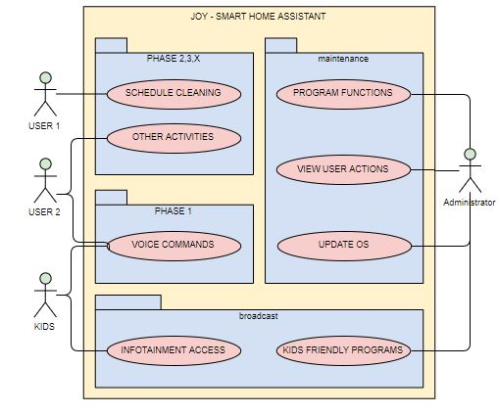

Slide 20
PROS AND CONS
PROS
CONS
1.Light weight , compact, easily transportable
2.Manually Programmable for multipurpose
3.Runs on android, ios, windows platforms
Whole smart home configuration can be done at this single device
Secured network.. And the administrator retina/fingerprint recognized program rescheduling
Doesn’t care about the power source.
1.Compact, hence complex in making and fixing
2. Large number of threads may cause time delays
3. Updating maybe somewhat long process as it should support different OS
4. May not roll efficiently on terrains (maybe upgraded)
5.Need support arms to climb stairs..

Slide 21
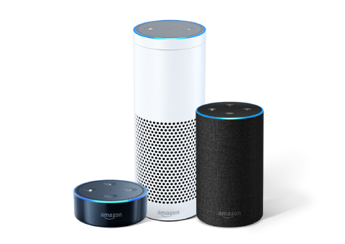
PHASE 1
JOY 1.0
Just an alternative to other home assistants like Alexa.
The difference in the mode of operation is how it responds and the way it recognizes commands

Slide 22
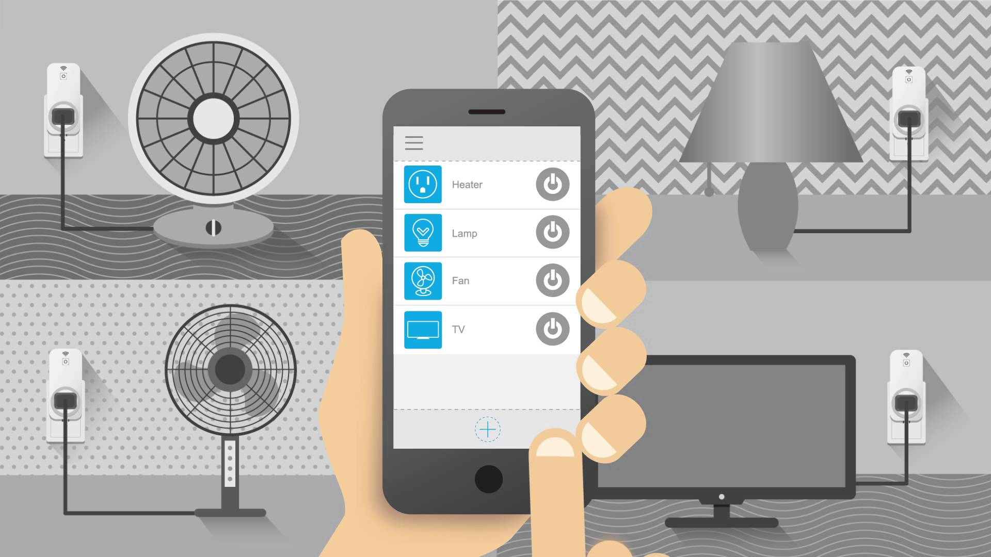
PHASE 2
Controlling switch based electrical equipment using AI

Slide 23
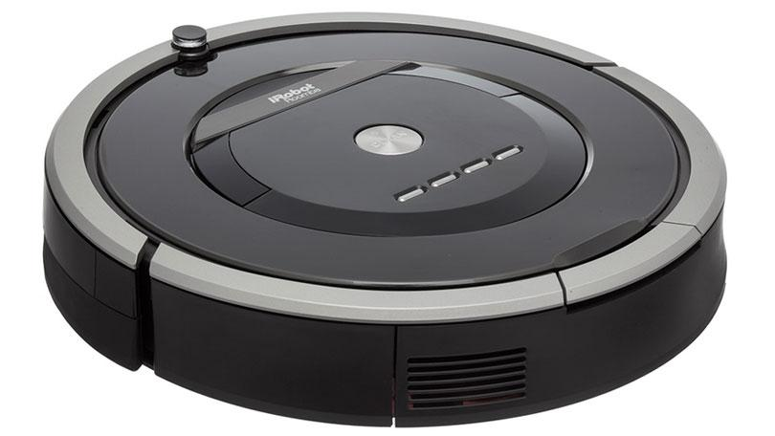
PHASE 3
Guiding Vacuum cleaners using ML algorithm to find contaminants

Slide 24
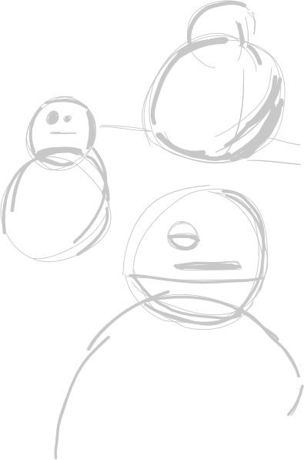
PHASE X
Health care
Image recognizer
Hologram viewer
Sleep Simulator
BANKING
360d cam
Transport Assistant
Educational Purposes
Hologram recorder
Alarm
Security
Entertainment
Activity Manager
Translator
Text to read
Bill Verifying
Scans for lost items
Capturing Moments
The list goes on..

Slide 25
REFERENCES
ALEXA SCEINCE : https://developer.amazon.com/alexa/science
PAPER : "Efficient Large-Scale Neural Domain Classification with Personalized Attention“
http://pages.cs.wisc.edu/~ybkim/paper/acl2018.pdf
DEEP LEARNING AND NEURAL NETWORKS : http://neuralnetworksanddeeplearning.com/chap6.html
GOOGLE ASSISTANT : https://www.blog.google/products/assistant/
https://ai.googleblog.com/2018/08/Multilingual-Google-Assistant.html
https://assistant.google.com/intl/en_in/#?modal_active=none
BB-8 : https://howbb8works.com/
SIRI : https://magoosh.com/data-science/siri-work-science-behind-siri/
https://www.apple.com/siri/
YOUTUBE : AIDO ROBOT https://www.youtube.com/watch?v=pGb8q2l23z0
JIBO https://www.youtube.com/watch?v=vaCAiJ6NP3k
MIKO https://www.youtube.com/watch?v=ysG6C02Fmog

Slide 26
BOOKS TO REFER FOR FURTHER RESEARCH
ANN and DEEP LEARNING
Goodfellow, Bengio, and Courville’s Deep Learning text.
Neural Networks and Deep Learning by Michael Nielsen
ROBOTICS AND HOME AUTOMATION (Including IoT)
Smart Homes: Design, Implementation and Issues by
Nagender Kumar Suryadevara
The Second Machine Age: Work, Progress and Prosperity in a Time of Brilliant
Technologies by Erik Brynjolfsson and Andrew McAfee.
The Silent Intelligence by Daniel Kellmereit and Daniel Obodovski
Everyware: The dawning age of ubiquitous computing
by Adam Greenfield
And many more....

